Slide 1


Metal Lyrics Generator
Team 3: Melicus Robotica
Eileen Blum, Angelo Taranto
Building a WGAN to generate metal song lyrics
https://github.com/eileenblum/Lyric-Generator
The Erdős Institute Spring 2021 NLP Bootcamp

Slide 2
The Question and Goals
Facts: Current AI can generate sentences, but often struggles to create natural sounding linguistic texts.
Question: Can an artificial generator capture the lyrical style of metal?
Goal: Use a Wasserstein Generative Adversarial Network (WGAN) to create new song lyrics based on lyrics from the metal genre.

Slide 3
Our Approach
Data gathering and cleaning
We downloaded the Large Metal Lyrics Archive from Kaggle:
228000 songs scraped from http://www.darklyrics.com
We used NLTK and NumPy for preprocessing and stored lyrics in a Pandas dataframe
Text Generation
We trained a WGAN and compared it with a Soft-GAN (Haidar et al., 2019). Inputs were length 8 integer vectors of corpus indices.
“The promises you make, your mind so blank”
→ [“The”, “promises”, “you”, “make”, “your”, “mind”, “so”, “blank”]
→ [121, 3203, 9, 150, 943, 609, 78, 2055]
After decoding, the generated vectors’ entries were rounded to integers.

Slide 4
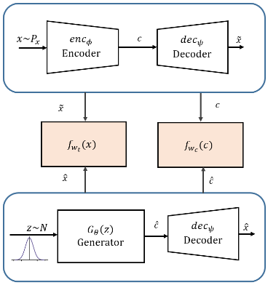
Autoencoder + WGAN
We used Keras and Tensorflow to create and train the different layers of the WGAN.
Architecture: Here, 𝑓_{𝑤} is the discriminator which tells real encoded representations from fake ones.
Encoder-decoder network (sequential LSTM layers) is trained first
then generator-discriminator network is trained in latent space of encoder-decoder network
Final row shows the trained generator generating encoded lines and the trained decoder decoding them.

Slide 5
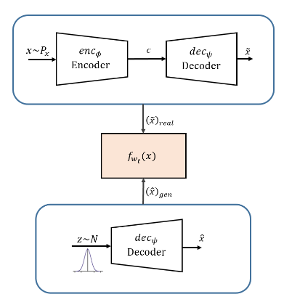
Soft-GAN
We also implemented the Soft-GAN model for comparison against our separated encoder/decoder and WGAN model.
Architecture:
Encoder/decoder network trained to pass discriminator’s (𝑓_{𝑤}) judgment.
At the same, time discriminator is trained to detect fake lines that decoder generates from Gaussian noise

Slide 6
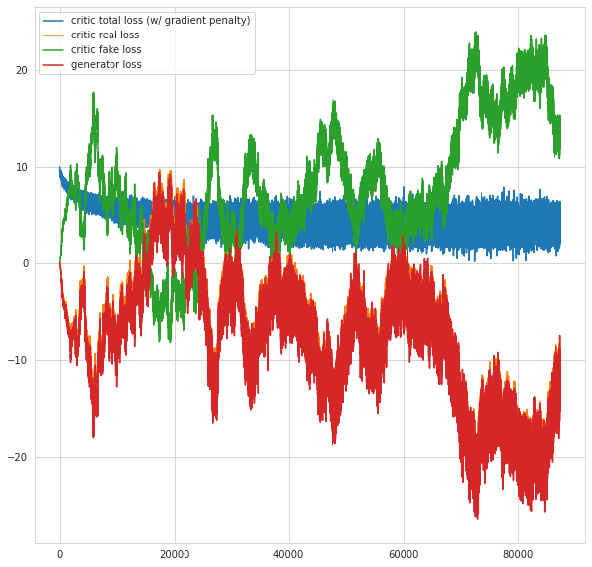
Results
WGAN Loss Plot
We calculated BLEU scores for both models.
WGAN
Example: “aviation unoxidized tum dieb regency knowledgeless spoliate ceratoid”
Cumulative 1-gram: 0.00, 2-gram: 0.00, 3-gram: 0.00, 4-gram: 0.00
Soft-GAN
Example: “abysmal stink folded pollute submit discipline unbeliever powerlessness”
Cumulative 1-gram: 0.000494, 2-gram: 0.022218, 3-gram: 0.081064, 4-gram: 0.149058
Notes:
BLEU score calculates the number of n-grams in the generated lines that match n-grams found in lines from the original data. The idea being that more matches makes for a more natural sounding line of English lyrics. Scores range from 0-1 with 1 being an identical match.

Slide 7
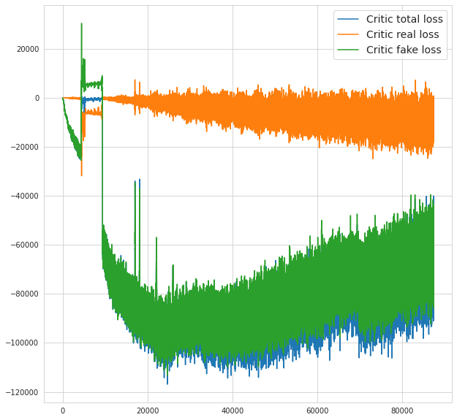
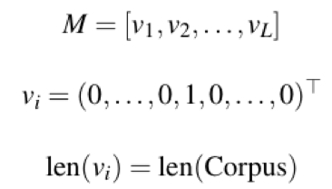
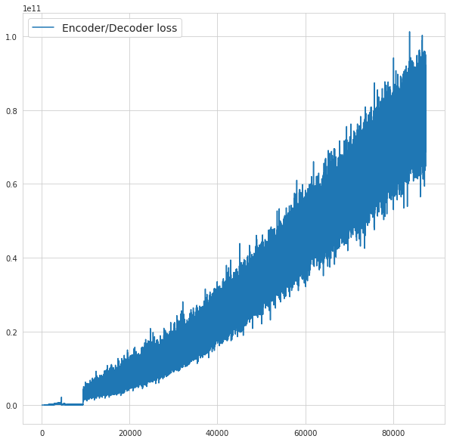
Challenges
Next Steps
Need a better way to convert text data into numerical inputs
Soft-GAN’s discriminator learns faster than autoencoder
WGAN suffers from mode collapse!
Neither model generated natural sounding lines of text
Soft-
GAN
Loss
Plots
Try order-preserving one-hot-encoded bag of words matrix input:
Connect the training of the autoencoder to the WGAN - this is called LATEXT-GAN (Donahue & Rumshisky, 2018)
Adjust learning rate and autoencoder network parameters

Slide 8


Thank You!
TEAM 3: Melicus Robotica
https://github.com/eileenblum/Lyric-Generator
Eileen Blum
eileen.blum@rutgers.edu
Angelo Taranto
taranto.8@buckeyemail.osu.edu
The Erdős Institute Spring 2021 NLP Bootcamp

Slide 9
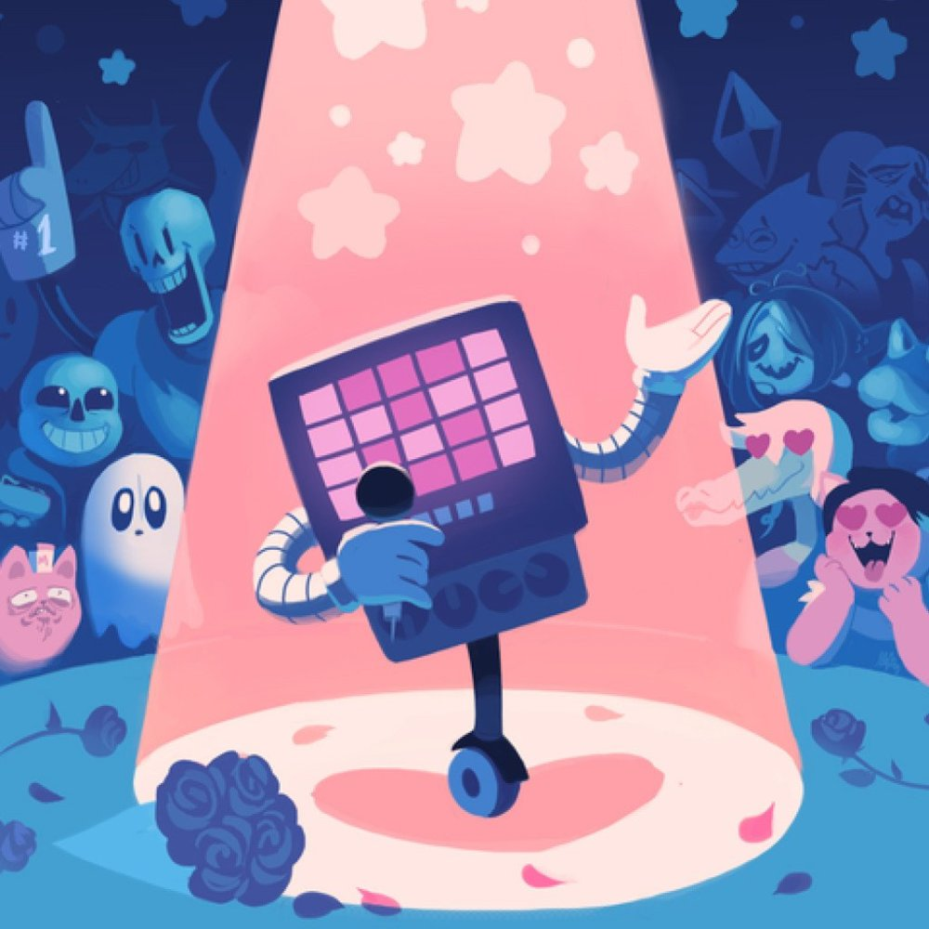
Example Lyrics
Soft-GAN: faithless swaggering cycle cheek imagine genocide plan command
aldern coincide employed orgy kingly obsolescent artificial calmly
slipknot razor model altar hostile sill unveil omnipotent
contrive sexual punch bloodshed unveil daisy issue backstage
WGAN: aviation unoxidized tum dieb regency knowledgeless spoliate ceratoid
aviation unoxidized tum dieb regency knowledgeless spoliate ceratoid
aviation unoxidized tum dieb regency knowledgeless spoliate ceratoid
aviation unoxidized tum dieb regency knowledgeless spoliate ceratoid

Slide 10
References
Arjovsky, M., Chintala, S., & Bottou, L. (2017). Wasserstein generative adversarial networks. In International conference on machine learning (pp. 214-223). PMLR.
Brownlee, J. (2017). A gentle introduction to calculating the BLEU score for text in Python. https://machinelearningmastery.com/calculate-bleu-score-for-text-python/
Donahue, D., & Rumshisky, A. (2018). Adversarial text generation without reinforcement learning. arXiv preprint arXiv:1810.06640. Gulrajani, I., Ahmed, F., Arjovsky, M., Dumoulin, V., & Courville, A. (2017). Improved training of wasserstein gans. arXiv preprint arXiv:1704.00028.
Haidar, M., Rezagholizadeh, M., Do-Omri, A., & Rashid, A. (2019). Latent code and text-based generative adversarial networks for soft-text generation. arXiv preprint arXiv:1904.07293.
Hochreiter, S., & Schmidhuber, J. (1997). Long short-term memory. Neural computation, 9(8), 1735-1780.
Lee, C.Y., Li, H., Hou, R., & Lim, C. (2021). Natural Language Toolkit: Bleu Score. https://www.nltk.org/_modules/nltk/translate/bleu_score.html
Papineni, K., Roukos, S., Ward, T., & Zhu, W. J. (2002, July). Bleu: a method for automatic evaluation of machine translation. In Proceedings of the 40th annual meeting of the Association for Computational Linguistics (pp. 311-318).
Radford, A., Metz, L., & Chintala, S. (2015). Unsupervised representation learning with deep convolutional generative adversarial networks. arXiv preprint arXiv:1511.06434.

